Slide 1
PROJECT AS PART OF CS6109 - COMPILER DESIGN
Movie Genre Classification
Based on Semantic Analysis
Presented by :
Aadithya Naresh - 2018103501
Sibi Akash M - 2018103594
Prathesh N - 2018103576

Slide 2
ABSTRACT
In the recent years, many researches are done in order to find the concepts within documents. These document units are language’s verbs, nouns, adverbs, prepositions etc. that contribute towards building the document. The current application is not limited by picking keywords to understand the document concept but aims to gain a precise understanding of concepts through correlation of words and to classify the documents. In our application we use the Latent Semantic Analysis (LSA) algorithm for movie classification. The training dataset is trained using the algorithm and a matrix is generated. This matrix gives us the correlation of words within documents. By finding the similarity of test dataset with the training dataset, the genre of the test data is classified.

Slide 3
LITERATURE SURVEY
S.NO | PUBLICATION YEAR | AUTHOR | METHODOLOGY | ADVANTAGES | LIMITATION
1 | March 15, 2017 | Rakshitha GS , Karthik KrishnaMurthi | Word stemming , Stop words removal , data pre – processing | The methodology improves four percentage points for efficiency in pre processing | The method could be further improved by taking more genre information
2 | January 5, 2001 | Yihong Gong, Xin Liu | Latent semantic Analysis | Text summarization solves the problem of presenting the information needed by a user in a compact form. | LSA has several limitations. The first one is that it does not use the information about word order, syntactic relations and morphologies. This kind of information can be necessary for finding out the meaning of words and texts.

Slide 4
LITERATURE SURVEY
S.NO | PUBLICATION YEAR | AUTHOR | METHODOLOGY | ADVANTAGES | LIMITATION
3 | 4th IEEE Conference 2016 | Alifrna Rizqi lahitani , Adhistya Erna Permannasari | Cosine similarity | Implemented the waiting of term frequency using TFIDF | Automated scoring depends on many factor and cases such as language etc..

Slide 5
PROBLEM STATEMENT
One of the major problems these days is tagging other movies which fall under similar kinds of storyline or share the same genre. In order to eliminate unnecessary confusion arising due to abundance of movie data online, there must be some software to reduce this conflict of manual tagging of genre. We resort to text summarization. In the current state we are in, huge amounts of time are wasted reading data. So we have implemented a method that takes the key points of the text and displays it. Latent semantic analysis is used here to develop short and concise summaries of their corresponding paragraphs.

Slide 6
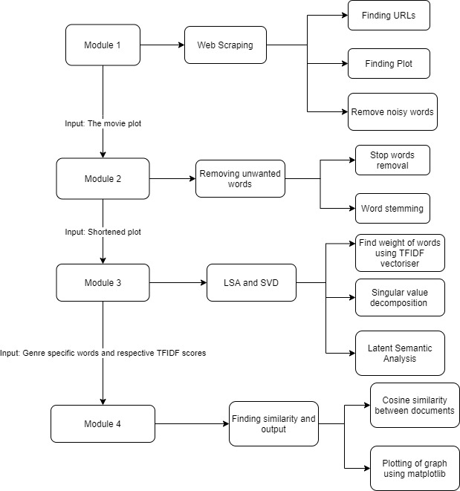
SYSTEM ARCHITECTURE

Slide 7
SYSTEM ARCHITECTURE

Slide 8
Module 1: WEB SCRAPPING
Packages used : urllib , beautiful soup , pandas
Input : csv file with movie title ,release year , genre and other columns.
Output : respective movie plots scraped from Wikipedia
Phases : 1. Scrap the plot
2. Fetch the required plot
3. Removing noisy words and nouns

Slide 9
PHASE 1. Scrap the plot
DESCRIPTION :
From the URL obtained we will have to scrape the plot. For most of the movies the story will be under the plot section. Moreover Wikipedia provides privilege to edit each section. So if we somehow are able to reach the section we can obtain the entire plot of the movie which was uploaded. All these scraping works are done by using Python’s Beautiful Soup.
PSEUDO CODE :
for i in df.index: //df contains all the movie records ...
movie_name = df[i]['Title']
movie_name = movie_name.title()
movie = ""
for i in range(len(movie_name)):
if movie_name[i] == ' ':
movie += '_'
else:
movie += movie_name[i]
df.loc[i]['Wiki Page'] = movie

Slide 10
PHASE 2. Fetch the required plot
Then we will have to fetch the required plot from the edit section.
PSEUDO CODE :
url = df.loc[i]['Wiki Page']
html = urlopen(url)
soup = BeautifulSoup(html, 'html.parser')
url = "https://en.wikipedia.org"+soup.find('a',{'title':'Edit section: Plot'})['href’]
It has lots and lots of noisy words which are wikipedia related syntaxes , moreover all those words were mostly redirects and also nouns which are nowhere useful in our context , so they’ll have to be removed.
PSEUDO CODE :
html = urlopen(url)
soup = BeautifulSoup(html, 'html.parser')
plot = soup.find('textarea').text

Slide 11
PHASE 3. Removing noisy words and nouns
PSEUDO CODE :
try:
i = plot.index('==')
plot = plot[i+len('=='):]
i = plot.index('==')
plot = plot[i+len('=='):]
except:
plot = plot
df.loc[i,'Plot'] = 'a'
def func(pl):
while(1):
i = pl.find('[[')
if(i==-1):
break
j = pl.find(']]')
pl = pl[:i] + pl[j+2:]
while(1):
i = pl.find('{{')
if(i==-1):
break
j = pl.find('}}')
pl = pl[:i] + pl[j+2:]
while(1):
i = pl.find('(')
if(i==-1):
break
j = pl.find(')')
pl = pl[:i] + pl[j+2:]
p = ''
for i in pl:
if(i!='\n'):
p += i
return p
DESCRIPTION :
The above code will, to some extent, remove the noisy words. Then the output is stored in the ‘Plot’ column . It is repeated for all the records in the table then it is later stored into the file from which the input was extracted.

Slide 12
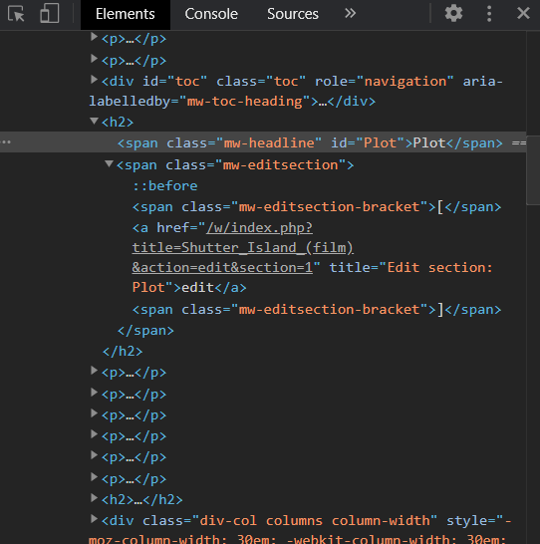
Screenshots of each modules
MODULE 1
We can see from the above picture that the edit section is below the Plot’s <span>.
We will fetch the edit section’s url by finding for the <a>’s href.

Slide 13
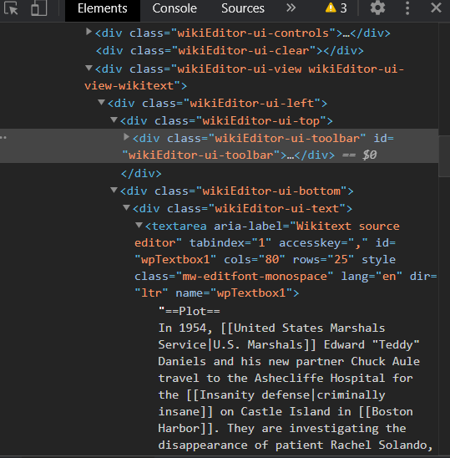
MODULE 1
The entire plot is in the <textarea>’s innerText.

Slide 14
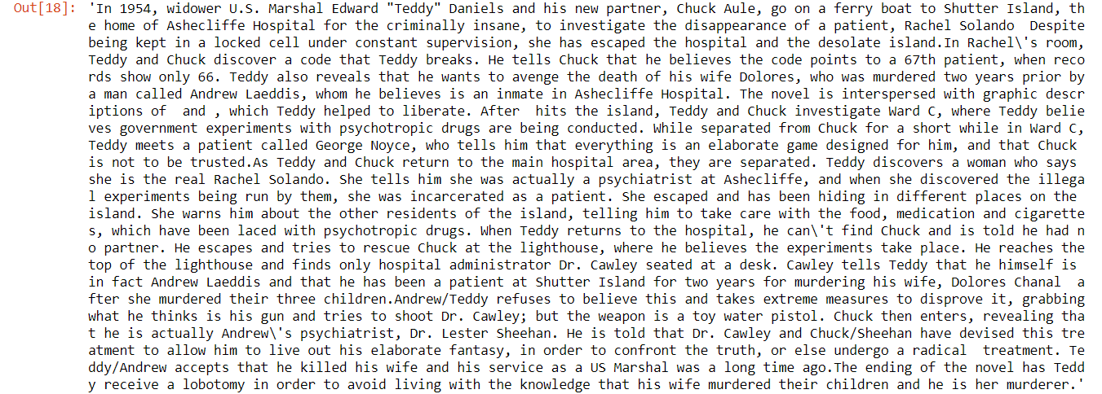
MODULE 1
Movie Plot scrapped from wikipedia for the movie Shutter Island

Slide 15
Module 2: STOP WORDS REMOVAL
AND WORD STEMMING
Packages Used : nltk
Input : Plot of the movie.
Output : Stemmed words.
Phases :
1. Stop words removal
2. Word stemming

Slide 16
Phases : 1. Stop words removal
DESCRIPTION :
We will have to split the plot into words using nltk’s word tokenizer. The first thing we will have to remove is the character names, places in which the story happens , generalising it we need to remove the nouns.
PSEUDO CODE :
tagged_sentence = nltk.tag.pos_tag(plot.split())
edited_sentence = [word for word,tag in tagged_sentence if tag != 'NNP' and tag != 'NNPS']
example_sentence = ' '.join(edited_sentence)

Slide 17
Phases : 2. Word stemming
DESCRIPTION :
Then the stop words removed list is stemmed using nltk’s Porter Stemmer algorithm. The Porter stemming algorithm or ‘Porter stemmer’ is a process for removing the commoner morphological and in flexional endings from words in English
PSEUDO CODE :
punctuations = '''!()-[]{};:'"\,<>./?@#$%^&*_~0123456789'''
no_punct = ""
for char in example_sentence:
if char not in punctuations:
no_punct = no_punct + char
else:
no_punct += ' '
example_sentence = no_punct
tagged_sentence = nltk.tag.pos_tag(example_sentence.split())
edited_sentence = [word for word,tag in tagged_sentence if tag not in ['NNP','NNPS','NNS','NN']]
print(len(edited_sentence))
example_sentence = ' '.join(edited_sentence)
example_sentence = example_sentence.lower()
stop_words = set(stopwords.words('english'))
word_tokens = word_tokenize(example_sentence)
filtered_sentence = [w for w in word_tokens if not w in stop_words]

Slide 18
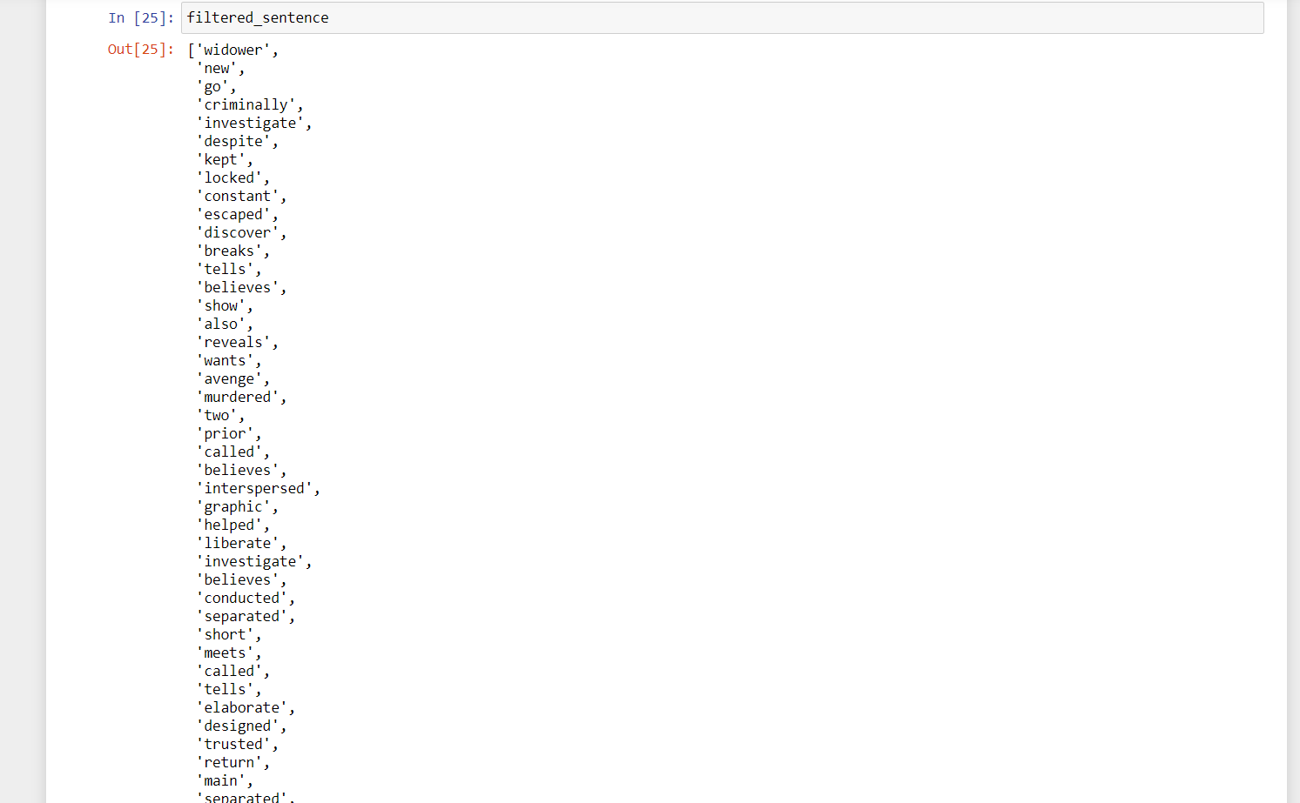
MODULE 2
filt = [ps.stem(filtered_sentence[i]) for i in range(len(filtered_sentence))]

Slide 19
Module 3: LSA and SVD of stemmed words
Packages Used : sklearn’s feature extraction.
Input : Space separated stemmed words.
Output :An Array of genre related words.
Phases :
1. Computing TF and DF
2. Forming TFIDF
3. Singular value decomposition

Slide 20
Phases : 1. Computing TF and DF
PSEUDO CODE :
def computeTF(wordDict, bagOfWords):
tfDict = {}
bagOfWordsCount = len(bagOfWords)
for word, count in wordDict.items():
tfDict[word] = count / float(bagOfWordsCount)
return tfDict
where wordDict expects an array of <word , count > pair in a particular document
PSEUDO CODE :
def computeIDF(documents):
N = len(documents)
idfDict = dict.fromkeys(documents[0].keys(), 0)
for document in documents:
for word, val in document.items():
if val > 0:
idfDict[word] += 1
for word, val in idfDict.items():
idfDict[word] = math.log(N / float(val))
return idfDict
Then tfidf of a document is obtained by multiplying tf and idf values.

Slide 21
Phases : 2. Forming TFIDF
DESCRIPTION :
Based on the tfidf values the matrix will be compressed and the most commonly appearing words will be selected along with their tfidf scores.
PSEUDO CODE :
def computeTFIDF(tfBagOfWords, idfs):
tfidf = {}
for word, val in tfBagOfWords.items():
tfidf[word] = val * idfs[word]
return tfidf

Slide 22
Phases : 3. Singular value decomposition
DESCRIPTION :
Truncated SVD is used for selection of various topics from the document array. Number of topics can be passed as an argument via n_components .
PSEUDO CODE :
vectorizer = TfidfVectorizer(min_df = 200,stop_words='english',max_df = 0.9,max_features = 500) bagofwords = vectorizer.fit_transform(plot)
svd = TruncatedSVD(n_components = ncomp)
lsa = svd.fit_transform(bagofwords)

Slide 23
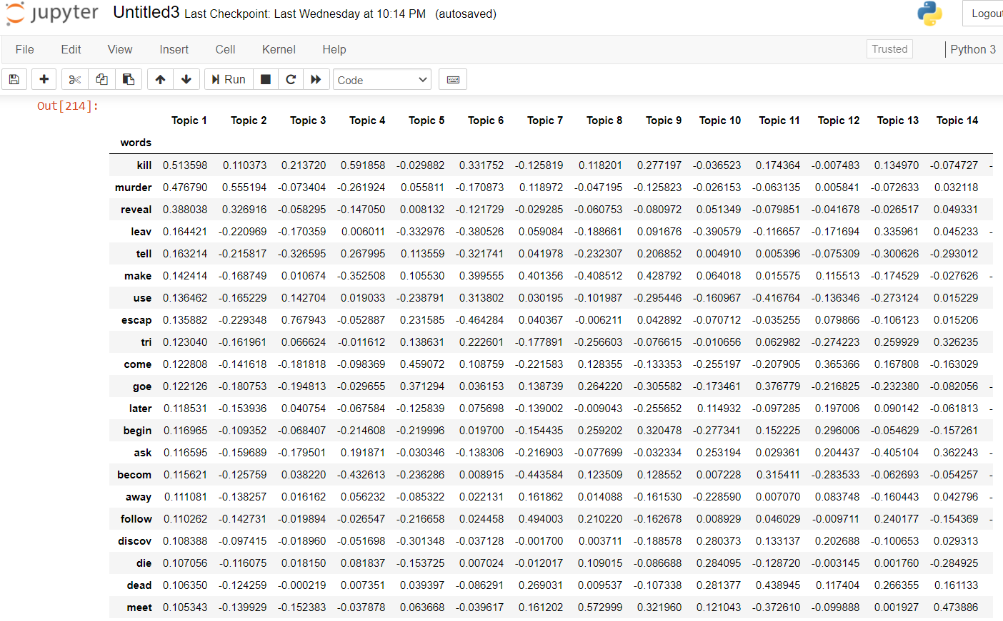
MODULE 3
These are the words selected for thriller genre and their corresponding scores in various topics among this one of the topics will be selected by finding the maximum sum obtained by the test plots which was separated earlier.

Slide 24
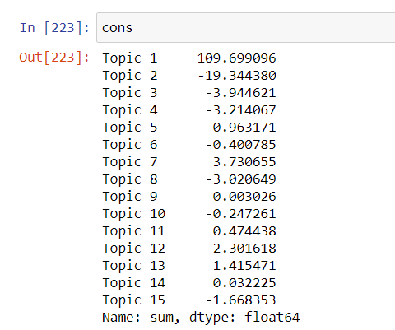
MODULE 3
Sum obtained by the respective topics

Slide 25
Module 4 : Prediction of genres of the movie plot
Packages Used : sklearn’s feature extraction, cosine similarity and matplotlib.
Input : Genre specific words and their tfidf scores.
Output : A simple classification graph .
Phases :
1. Cosine similarities method
2. Plotting graph using matplotlib

Slide 26
Phases : 1. Cosine similarities method
DESCRIPTION :
Cosine similarity is a metric used to measure how similar the documents are irrespective of their size. Mathematically, it measures the cosine of the angle between two vectors projected in a multi-dimensional space.
PSEUDO CODE :
rat = df2.iloc[df2.shape[0]-len(summa):]
rat = rat.T
rat.index.set_names(['words'],inplace = True)
encoding_matrix = pd.DataFrame(svd.components_,index = topic).T
encoding_matrix['words'] = diction30
diction30 = encoding_matrix.sort_values(by=['Topic 1'],ascending = False)
diction30.index = diction30['words']
topic.remove(top)
diction30 = diction30.drop(topic,axis = 1)
diction30 = diction30.drop(['words'],axis = 1)
comp = pd.concat([rat,diction30], axis=1, join='inner').T
c = cosine_similarity(comp,comp)

Slide 27
Phases : 2. Plotting graph using matplotlib
DESCRIPTION :
Finally the classification is done via bar graph which shows the diversification of the movie plots among the various genres.
PSEUDO CODE :
color = ['#4b0082','#ffd700','#ff4500','#4b0082','#adff2f','#2f4f4f','#00ee4e','#eeee02','#dc143c']
genre = ans.index.values
genre = [genre[i].title() for i in range(len(genre))]
fig, axs = plt.subplots(math.ceil(ans.shape[1]/2), 2,figsize = (20, 50))
count = 0
for i in ans.columns.values:
nsix = ans[i] * 100
axs[(count//2),count%2].bar(genre,nsix.values,color =color, width = 0.4)
axs[(count//2),count%2].set_title(i)
count+=1
plt.show()

Slide 28
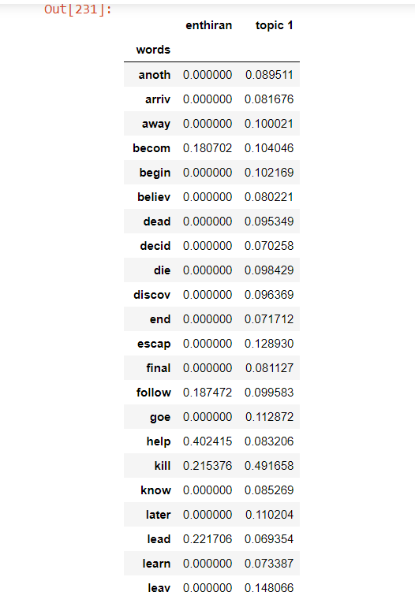
MODULE 4
Tfidf scores of thriller dataset and input plot for which cosine similarity needs to be calculated.

Slide 29
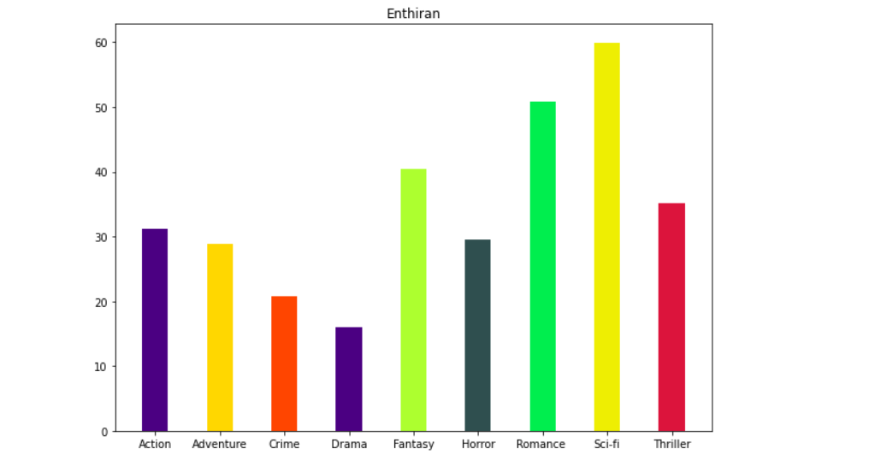
MODULE 4
An example classification graph for a science fiction movie

Slide 30
REFERENCES
[1] Dr. Edel Garcia “Latent Semantic Indexing (LSI) A Fast Track Tutorial”, FirstPublished on September 21, 2006 Last Update: October 21, 2006
[2] Kanejiya, A. Kumar and S. Prasad, “Automatic Evaluation of StudentsAnswers using Syntactically Enhanced LSA”, Workshop on BuildingEducational Applications using NLP, 53–60, 2003.
[3] Pimwadee Chaovalit, Lina Zhou “Movie Review Mining: a Comparisonbetween Supervised and Unsupervised Classification Approaches”,Proceedings of the 38th Hawaii International Conference on System Sciences– 2005.
[4] Karthik Krishnamurthi1, Vijayapal Reddy Panuganti2, Vishnu VardhanBulusu3, Influence of Supplementary Information on the Semantic Structureof Documents, International Journal of Advanced Research in Computer andCommunication Engineering Vol. 4, Issue 7, July 2015.

